Slide 1


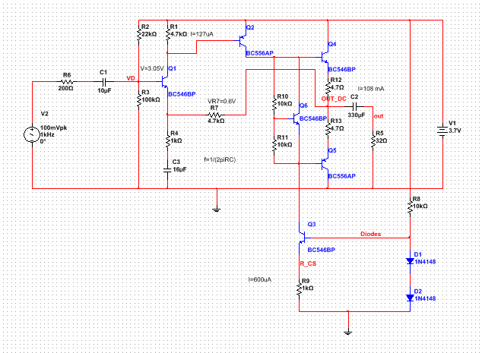
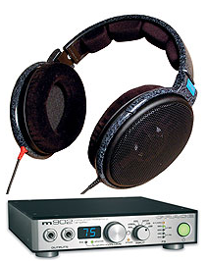
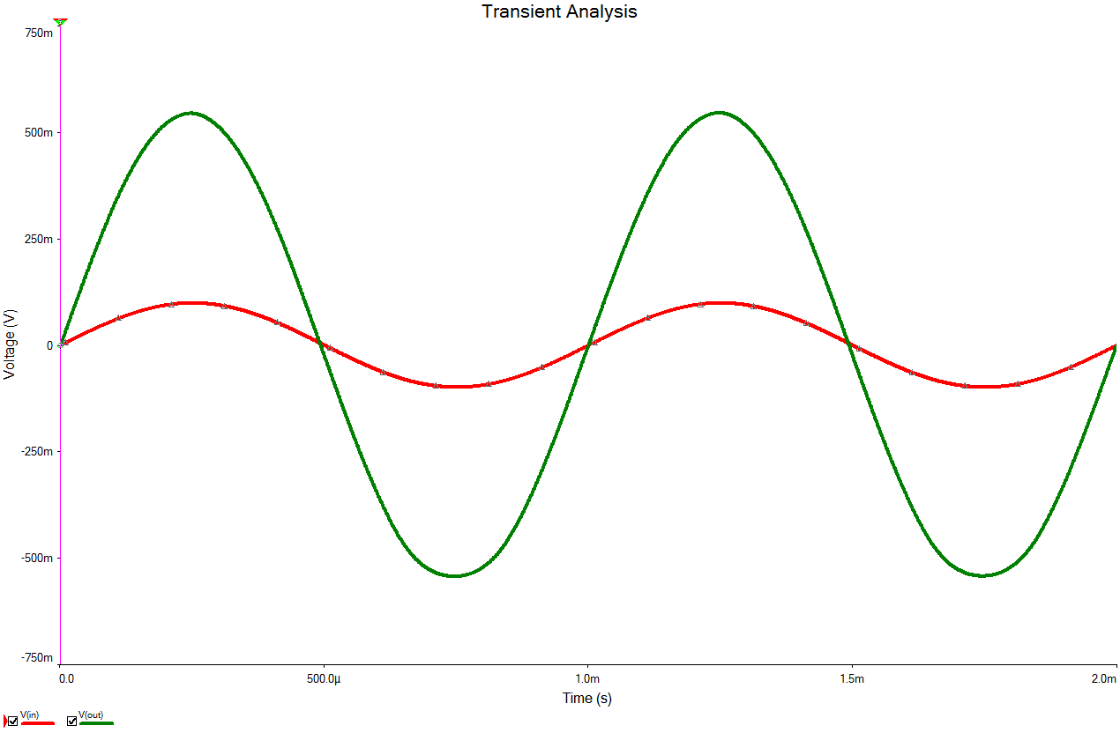
Headphone Amplifier
Junyang Ma
Department of Electronic Engineering, ITT Dublin, Tallaght, Dublin 24, Ireland.
specter4mjy@gmail.com
Project Objectives
Design a high quality headphone amplifier
Figure2: headphone amplifier circuit
Figure1: headphone amplifier product
Potential Issues
Battery voltage is low , like 3.7 volts.
Need to consider about the battery life.
Load resistor is small , like 32Ω.
Figure3: simulation output

